Slide 1
MIPS Arithmetic
All instructions have 3 operands
One destination, two operands
Operand order is fixed (destination first)
Example: C code: a = b + c MIPS code: add a,b,c
C code: a = b + c + d; MIPS code: add a, b, c add a, a, d
Design principle: Hardware implementation is simplified via regularity
Operands must be registers in MIPS
Register set of a machine is a limited number of special locations built directly into the hardware
Notes:
Keep Hardware simple via regularity

Slide 2
Assembly Variables: Registers
Unlike HLL, assembly cannot use variables
Why not? Keep hardware simple
Different operand locations for different architectures
Stack, register, memory or a mix of them
Every architecture design after 1980 uses a load-store register architecture: ALU operands are all registers; memory can only be accessed with load/store
Advantages of load-store register architectures
Registers are faster than memory
Registers are more efficient for a compiler to use
Drawback: the no. of registers is predetermined
Assembly code must be very carefully put together to efficiently use registers
Notes:
Register-register: MIPS, SPARC, PowerPC, DEC Alpha
Registers are directly in hardware, they are very fast (less than 1 billionth of a second)
More efficient than other forms of internal storage

Slide 3
MIPS Registers
32 registers in MIPS
Why 32? Design principle: Smaller is faster
Registers are numbered from 0 to 31
Each register can be referred to by number or name
Number references: $0, $1, … $30, $31
By convention, each register also has a name to make it easier to code
$t0 - $t7 for temporary variables ($8- $15)
$ra for return address
Each MIPS register is 32 bits wide
Groups of 32 bits called a word in MIPS

Slide 4
MIPS Arithmetic with Registers
MIPS Example
C code: a = b + c MIPS code: add $s1,$s2,$s3
C code: a = b + c + d; MIPS code: add $t1,$s2,$s3 add $s1,$t1,$s4
$s0-$s7 conventionally are used for registers that correspond to variables in C/Java programs ($16-$23)

Slide 5
MIPS Instructions
Syntax of instructions:
op dest, src1, src2
Op: operation by name
Dest: operand getting result (“destination”)
Src1: 1st operand for operation (“source1”)
Src2: 2nd operand for operation (“source2”)
Each line of assembly code contains at most 1 instruction
Hash (#) is used for MIPS comments
Anything from hash mark to end of line is a comment and will be ignored
Every line of your comments must start with a #

Slide 6
Addition/Subtraction Example
How to do the following C statement?
a = b + c + d - e;
Break into multiple instructions
add $t0, $s1, $s2 #temp = b + c
add $t0, $t0, $s3 #temp = temp + d
sub $s0, $t0, $s4 #a = temp - e
Notice
A single line of C code may break up into several lines of MIPS code
May need to use temporary registers ($t0 - $t9) for intermediate results
Everything after the hash mark on each line is ignored (comments)

Slide 7
Constant or Immediate Operands
Immediates are numerical constants
They appear often in code, so there are special instructions for them
Design principle: Make the common case fast
Add Immediate:
C code : f = g + 10
MIPS code: addi $s0,$s1,10
MIPS registers $s0, $s1 are associated with C variables f, g
Syntax similar to add instruction, except that last argument is a number instead of a register
How about subtraction? subi?

Slide 8
Constant or Immediate Operands
There is NO subtract immediate instruction in MIPS: Why?
ISA design principle: limit types of operations that can be done to minimum
If an operation can be decomposed into a simpler operation, do not include it
addi …, -X = subi …, X => so no subi
Example
C code: f = g - 10
MIPS code: addi $s0,$s1,-10
MIPS registers $s0,$s1 are associated with C variables f, g

Slide 9
Register Zero
One particular immediate, the number zero (0), appears very often in code
So we define register zero ($0 or $zero) to always have the value 0
Often used to move values or set constant values
f = g (in C)
add $s0,$s1,$zero (in MIPS)
MIPS registers $s0, $s1 are associated with C variables f, g
$zero defined in hardware
Instruction add $zero,$zero,$s0 will not do anything!

Slide 10
Memory Organization
Viewed as a large, single-dimension array
A memory address is an index into the array
"Byte addressing" means that the index points to a byte of memory
0
8 bits of data
1
8 bits of data
2
8 bits of data
3
8 bits of data
4
8 bits of data
5
8 bits of data
6
8 bits of data
...

Slide 11
Memory Organization
Bytes are nice, but most data items use larger "words"
For MIPS, a word is 32 bits or 4 bytes
MIPS register holds 32 bits of data
2³² bytes with byte addresses from 0 to 2³²-1
2³⁰ words with byte addresses 0, 4, 8, ... 2³²-4
Words are aligned: they must start at addresses that are multiples of 4
0
32 bits of data
4
32 bits of data
8
32 bits of data
12
32 bits of data
...
Notes:
i.e., what are the least 2 significant bits of a word address?

Slide 12
Specify Memory Addresses
To transfer data, we need to specify:
Register: specify this by number ($0 - $31) or symbolic name ($s0,…, $t0, …)
Memory address: supply a pointer/index to the byte-addressed one-dimensional array
Often, we want to be able to offset from a pointer: e.g. element A[2], date.month
The general format for a memory address offset(base register) specifying
A register containing a pointer to memory
A numerical offset (in bytes)
The desired memory address is the sum of these two values
Example: 8($t0) specifies memory[$t0+8] (byte)
Notes:
the memory address pointed to by the value in $t0, plus 8 bytes

Slide 13
Data Transfer Instructions
MIPS has two basic data transfer instructions for accessing memory
lw $t0,4($s3) #load word from memory
sw $t0,8($s3) #store word to memory
Load instruction syntax: lw reg1, offset(reg2)
Operator name: lw (meaning Load Word, so 32 bits or one word are loaded at a time)
Reg1: register that will receive the transferred data
Offset: a numerical offset in bytes
Reg2: register containing pointer to memory, called base register

Slide 14
Load Word Example
Data flow
Example: lw $t0,12($s0)
This instruction will take the pointer in $s0, add 12 bytes to it, and then load the value from the memory pointed to by this calculated sum into register $t0
$s0 is called the base register
12 is called the offset
Offset is generally used in accessing elements of array or structure: base register points to beginning of array or structure

Slide 15
Store Instruction
Also want to store from register into memory
sw: meaning Store Word, so 32 bits or one word are loaded at a time)
Store instruction syntax is identical to Load’s
Example: sw $t0,12($s0)
This instruction will take the pointer in $s0, add 12 bytes to it, and then store the value from register $t0 into that memory address
Remember: “Store INTO memory”
Data flow

Slide 16
Example
C code: A[12] = h + A[8]; MIPS code:
lw $t0, 32($s3) # base addr of array A in $s3
# 1 array element is 4-byte
add $t0, $s2, $t0 # h is associated with $s2 sw $t0, 48($s3) # offset=12*4=48
Can refer to registers by name (e.g., $s2, $t2) instead of number
Store word has destination last
Remember arithmetic operands are registers, not memory!
Can’t write: add 48($s3), $s2, 32($s3)

Slide 17
Pointers vs. Values
Key concept: a register can hold any 32-bit value
That value can be a signed int, an unsigned int, a pointer (memory address), and so on
If you write add $t2,$t1,$t0, then $t0 and $t1 better contain values
If you write lw $t2,0($t0), then $t0 better contains a pointer
Don’t mix these up!

Slide 18
Loading & Storing Bytes
In addition to word data transfers, MIPS has byte data transfers for characters (char type)
Load byte: lb; store byte: sb
Same format as lw, sw
What to do with other 24 bits in the 32 bit register?
lb: sign extends to fill upper 24 bits
Normally do not want to sign extend chars
MIPS instruction that does not sign extend when loading bytes -- load byte unsigned: lbu
xxxx xxxx xxxx xxxx xxxx xxxx
x
zzz zzzz
byte loaded
…is copied to “sign-extend”
This bit

Slide 19
C Decisions: if Statements
2 kinds of if statements in C
if (condition) clause
if (condition) clause1 else clause2
Rearrange if-else using goto and labels into:
if (condition) goto L1;
clause2;
goto L2;
L1: clause1;
L2:
Not as elegant as if-else, but same meaning

Slide 20
MIPS Decision Instructions
Decision instructions in MIPS
beq register1, register2, L1
beq is “branch if equal”
same meaning as: if (register1==register2) goto L1
bne register1, register2, L1
bne is “branch if not equal”
same meaning as: if (register1!=register2) goto L1
Called conditional branches
Can be used to implement complex control-flow constructs for high level langauages

Slide 21
MIPS Goto Instruction
In addition to conditional branches, MIPS has an unconditional branch:
j label
Called a Jump Instruction: jump (or branch) directly to the given label without needing to satisfy any condition
Same meaning as: goto label
Technically, it’s the same as:
beq $0,$0,label
Condition always satisfied

Slide 22
Compiling C if into MIPS
(true) i == j
(false) i != j
i == j?
C code
if (i == j) f=g+h; else f=g-h;
Use mapping:
f: $s0, g: $s1, h: $s2, i: $s3, j: $s4
Final compiled MIPS code:
beq $s3,$s4,True # branch i==j
sub $s0,$s1,$s2 # f=g-h(false)
j Fin # goto Fin
True: add $s0,$s1,$s2 # f=g+h (true)
Fin:
Note: Compiler automatically creates labels to handle decisions (branches)
f=g+h
f=g-h
Exit
Notes:
). Generally not found in HLL code.

Slide 23
Loops in C/Assembly (1/3)
Simple loop in C; A[] is an array of integers
do { g = g + A[i];
i = i + j;
} while (i != h);
Rewrite this as:
Loop: g = g + A[i]; i = i + j; if (i != h) goto Loop;
Use this mapping: g, h, i, j, base of A $s1, $s2, $s3, $s4, $s5

Slide 24
Loops in C/Assembly (2/3)
Original code:
Loop: g = g + A[i]; i = i + j; if (i != h) goto Loop;
Final compiled MIPS code:
Loop: sll $t1,$s3,2 #$t1= 4*i add $t1,$t1,$s5 #$t1=addr A lw $t1,0($t1) #$t1=A[i] add $s1,$s1,$t1 #g=g+A[i] add $s3,$s3,$s4 #i=i+j bne $s3,$s2,Loop# goto Loop # if i!=h
Notes:
Do goto first
Then I = I + J
Then 1st 4

Slide 25
Loops in C/Assembly (3/3)
There are three types of loops in C:
while
do… while
for
Each can be rewritten as either of the other two, so the method used in the previous example can be applied to while- and for- loops as well
Key concept: though there are multiple ways of writing a loop in MIPS, the key to decision making is conditional branch
Notes:
Switch as HW? Quiz?

Slide 26
Inequalities in MIPS (1/3)
General programs need to test < and > as well as equalities (== and != in C)
MIPS inequality instruction:
slt reg1,reg2,reg3
“Set on Less Than”
Meaning:
if (reg2 < reg3) reg1 = 1;
else reg1 = 0;
In computereeze, “set” means “set to 1”, “reset” means “set to 0”
reg1 = (reg2 < reg3);

Slide 27
Inequalities in MIPS (2/3)
How do we use this? Compile by hand: if (g<h) goto Less; #g:$s0, h:$s1
Answer: compiled MIPS code…
slt $t0,$s0,$s1 # $t0 = 1 if g<h bne $t0,$0,Less # goto Less # if $t0!=0 # (if (g<h)) Less:
Branch if $t0 != 0 ➔ (g < h)
Register $0 always contains the value 0, so bne and beq often use it for comparison after an slt instruction
A slt ➔ bne pair means if(… < …)goto…

Slide 28
Immediates in Inequalities
There is also an immediate version of slt to test against constants: slti
C loop
if (g >= 1) goto Loop
Loop: . . .
MIPS loop
slti $t0,$s0,1 # $t0 = 1 if # $s0<1 (g<1) beq $t0,$0,Loop # goto Loop # if $t0==0 # (if (g>=1)
A slt ➔ beq pair means if(… ≥ …)goto…

Slide 29
Bitwise Operations
Up until now, we’ve done arithmetic (add, sub,addi ), memory access (lw and sw), and branches and jumps
All of these instructions view contents of register as a single quantity (such as a signed or unsigned integer)
New perspective: view register as 32 raw bits rather than as a single 32-bit number
We may want to access individual bits (or groups of bits) rather than the whole
Two new classes of instructions: logical & shift operations

Slide 30
Logical Operators
Logical instruction syntax:
op dest, src1, src2
Op: operation name (and, or, nor)
Dest: register that will receive value
Src1: first operand (register)
Src2: second operand (register) or immediate
Accept exactly 2 inputs and produce 1 output
Benefit: rigid syntax⇒ simpler hardware
Why nor?
nor $t0, $t1, $t2 # $t0 = not ($t1 or $t2)
Immediate operands
andi, ori: both expect the third argument to be an immediate
Notes:
Nor $t0, $t1, $t2 # $t0 = not ($t1 or $t2), if $t2=0, $t0=not $t1

Slide 31
Uses for Logical Operators (1/3)
Use AND to create a mask
Anding a bit with 0 produces a 0 at the output while anding a bit with 1 produces the original bit
Example:
1011 0110 1010 0100 0011 1101 1001 1010
0000 0000 0000 0000 0000 1111 1111 1111
0000 0000 0000 0000 0000 1101 1001 1010
Mask retaining the last 12 bits

Slide 32
Uses for Logical Operators (2/3)
A bit pattern in conjunction with AND is called a mask that can conceal some bits
The previous example a mask is used to isolate the rightmost 12 bits of the bit-string by masking out the rest of the string (e.g. setting it to all 0s)
Concealed bits are set 0s, while the rest bits are left alone
In particular, if the first bit-string in the above example were in $t0, then the following instruction would mask it:
andi $t0,$t0,0xFFF

Slide 33
Uses for Logical Operators (3/3)
Similarly effect of OR operation
Oring a bit with 1 produces a 1 at the output while oring a bit with 0 produces the original bit
This can be used to force certain bits to 1s
Example
$t0 contains 0x12345678, then after this instruction:
ori $t0, $t0, 0xFFFF
$t0 contains 0x1234FFFF (e.g. the high-order 16 bits are untouched, while the low-order 16 bits are forced to 1s)

Slide 34
Shift
Move (shift) all the bits in a word to the left or right by a number of bits
Example: shift right by 8 bits
0001 0010 0011 0100 0101 0110 0111 1000
0000 0000 0001 0010 0011 0100 0101 0110
Example: shift left by 8 bits
0001 0010 0011 0100 0101 0110 0111 1000
0011 0100 0101 0110 0111 1000 0000 0000

Slide 35
Logical Shift Instructions
Shift instruction syntax:
op dest,reg,amt
Op: operation name
Dest: register that will receive value
Reg: register with the value to be shifted
Amt: shift amount (constant < 32)
MIPS logical shift instructions:
sll (shift left logical): shifts left and fills emptied bits with 0s
srl (shift right logical): shifts right and fills emptied bits with 0s
MIPS also has arithmetic shift instructions that fills with the sign bit

Slide 36
Stored Program Concept
Instructions are represented as numbers/bits
Programs are stored in memory — to be read or written just like data
Fetch & execute cycle
Instructions are fetched and put into a special register
Bits in the register "control" the subsequent actions
Fetch the “next” instruction and continue
memory for data, programs,
compilers, editors, etc.
Processor
Memory
Notes:
Computers built on 2 key principles:
1) Instructions are represented as numbers.
2) Therefore, entire programs can be stored in memory to be read or written just like numbers (data).
Simplifies SW/HW of computer systems:
Memory technology for data also used for programs

Slide 37
Instruction Representation
Instructions in MIPS are 32-bit long (one word) and divided into “fields”
Each field tells computer something about an instruction
We could define different fields for each instruction, but MIPS defines only three basic types of instruction formats due to simplicity
R-format: register format
I-format: immediate format
J-format: jump format

Slide 38
Instruction Formats
I-format: immediate format
Instructions with immediates
Excluding shift instructions
Data transfer instructions (since the offset counts as an immediate)
Branches (beq and bne)
J-format: jump format
j and jal (more details later)
R-format: used for all other instructions
It will soon become clear why the instructions have been partitioned in this way

Slide 39
R-Format Instructions (1/4)
Define six fields of the following number of bits each: 6 + 5 + 5 + 5 + 5 + 6 = 32
Each field has a name
Each field is viewed as a 5- or 6-bit unsigned integer, not as part of a 32-bit integer
5-bit fields can represent any number 0-31 (00000 - 11111) while 6-bit fields can represent any number 0-63 (000000-111111)
6
5
5
5
5
6
opcode
rs
rt
rd
shamt
funct

Slide 40
R-Format Instructions (2/4)
6
5
5
5
5
6
opcode
rs
rt
rd
shamt
funct
opcode: partially specifies the operation
Also implies the instruction format: opcode=0 for all R-type instructions
funct: combined with opcode, exactly specifies the instruction
rs (source register): generally register containing the 1st operand
rt (target register): generally register containing the 2nd operand (note that name is misleading)
rd (destination register): generally register which will receive the result of computation

Slide 41
R-Format Instructions (3/4)
Notes about register fields:
Each register field is exactly 5 bits, which means that it can specify any unsigned integer in the range 0-31
Each of these fields specifies one of the 32 registers by number
The word “generally” was used because there are exceptions that we’ll see later
E.g. multiplication will generate a result of 64 bit stored in two special registers: nothing important in the rd field

Slide 42
R-Format Instructions (4/4)
Final field: shamt
Shift amount: the amount a shift instruction will shift by
Shifting a 32-bit word by more than 31 is useless, so this field is only 5 bits (so it can represent the numbers 0-31)
This field is set to 0 in all but the shift instructions

Slide 43
R-Format Example
MIPS Instruction: add $8,$9,$10
Encode to decide the value of each field
opcode = 0, funct = 32 (look up in table in book)
rd = 8 (destination)
rs = 9 (first operand), rt = 10 (second operand)
shamt = 0 (not a shift)
Decimal number per field representation
Binary number per field representation
0
9
10
8
0
32
000000
01001
01010
01000
00000
100000

Slide 44
I-Format Instructions (1/4)
What about instructions with immediates?
5-bit field only represents numbers up to the value 31: immediates may be much larger
Ideally, MIPS would have only one instruction format for simplicity: unfortunately, we need to compromise
Still, try to define new instruction format that is partially consistent with R-format
The first three fields of both formats are the same size and have the same names
The rest three fields in R-format are merged to form a single field for the immediate operand
Notes:
Same format? Same length?

Slide 45
I-Format Instructions (2/4)
Define four fields of the following number of bits each: 6 + 5 + 5 + 16 = 32
Again, each field has a name
Design key
Only one field is inconsistent with R-format
Most importantly, opcode is still in the same location
6
5
5
16
opcode
rs
rt
immediate

Slide 46
I-Format Instructions (3/4)
6
5
5
16
opcode
rs
rt
immediate
opcode: uniquely specifies an instruction
No funct field
rs: specifies the only register operand (if there is one)
rt: specifies register which will receive result of computation
This is why it’s called the target register “rt”
Notes:
This also answers question of why R-format has two 6-bit fields to identify instruction instead of a single 12-bit field: in order to be consistent with other formats.

Slide 47
I-Format Instructions (4/4)
The immediate field
Used to specify immediates for instructions with a numerical constant operands
Used to specify address offset in data transfer instructions: lw, sw, etc.
Used to specify branch address in bne and beq
Range
Both positive and negative numbers
16 bits ➔ can be used to represent immediate up to 2¹⁶ different values
What if the number we want to represent is out of the range?

Slide 48
I-Format Example
MIPS Instruction: addi $21,$22,-50
Encode for each field
opcode = 8 (look up in table in book)
rs = 22 (register containing operand)
rt = 21 (target register)
immediate = -50 (by default, this is decimal)
Decimal number per field representation
Binary number per field representation
Hexadecimal representation: 22D5 FFCE_{hex}
Decimal representation: 584,449,998_{ten}
Negative number encoding: 2’s complement
8
22
21
-50
001000
10110
10101
1111111111001110

Slide 49
Large Immediates
Range of immediates is limited
Length of immediate field is 16 bits
Considered as a signed number (sign bit)
Arithmetic operands or address offset can be larger
32-bit data / address in MIPS
We need a way to deal with a 32-bit immediate in any I-format instruction
Solution:
Handle it in software + new instruction
Don’t change the current instructions: instead, add a new instruction to help out

Slide 50
Large Immediates
New instruction:
lui register, immediate
Load Upper Immediate
Takes 16-bit immediate and puts these bits in the upper half (high order half) of the specified register; lower half is set to 0s
Example:
Want to write: addi $t0,$t0, 0xABABCDCD
Need to write a sequence instead:
lui $at, 0xABAB ori $at, $at, 0xCDCD add $t0,$t0,$at

Slide 51
Immediates in Conditional Branches
Branch instructions bne and beq
Field rs and rt specify registers to compare
Field immediate specify branch address
16 bit is too small since we have 32-bit pointer to memory
Observation
Branches are used for if-else, while-loop, for-loop: tend to branch to a nearby instruction
We only need to know the difference between the branch target and the current instruction address, which is much smaller and 16-bit addressing might suffice in most cases
opcode
rs
rt
immediate
Notes:
Half of all conditional branches Spec2000 benchmarks go to locations < 16 instructions away

Slide 52
PC-Relative Addressing
Solution to branches in a 32-bit instruction: PC-relative addressing
PC is the special register containing the address of the current instruction
New program counter = PC + branch address
Let the 16-bit immediate field be a signed two’s complement integer to be added to the PC if we take the branch
Now we can branch ± 2¹⁵ bytes from the PC, which should be enough to cover almost any loop
Any ideas to further optimize this?

Slide 53
PC-Relative Addressing
Note: Instructions are words, so they are word aligned
The byte address of an instruction is always a multiple of 4, i.e. it must end with 00 in binary
⇒The number of bytes to add to the PC will always be a multiple of 4
⇒Specify the immediate in words
Now, we can branch ± 2¹⁵ words from the PC (or ± 2¹⁷ bytes), so we can handle loops 4 times as large

Slide 54
Branch Address Calculation
Calculation:
If we do not take the branch:
PC = PC + 4
PC+4 = byte address of next instruction
If we do take the branch:
PC = (PC + 4) + (immediate * 4)
Observations
Immediate field specifies the number of words to jump, which is simply the number of instructions to jump
Immediate field can be positive or negative
Due to hardware, add immediate to (PC+4), not to PC; will be clearer why later in course

Slide 55
J-Format Instructions
J-format is used by MIPS jump instructions
j and jal
6-bit opcode + 26-bit jump address
Key concepts
Keep opcode field identical to R-format and I-format for consistency
Combine all other fields to make room for large target address
Goto statements and function calls tend to have larger offsets than branches and loops
6 bits
26 bits
opcode
target address

Slide 56
J-Format Addressing
We have 26 bit to specify the target address
We cannot fit both a 6-bit opcode and a 32-bit address into a single 32-bit word, so we compromise
Like branches, jumps will only jump to word aligned addresses ⇒ the 26-bit field covers 28 bits of the 32-bit address space
Where do we get the other 4 bits?
Take the 4 highest order bits from the PC
Technically, this means that we cannot jump to anywhere in memory, but it’s adequate 99.9999…% of the time, since programs aren’t that long
Only if straddle a 256 MB boundary
If we absolutely need to specify a 32-bit address, we can always put it in a register and use the jr instruction
Notes:
last two bits are always 00 (in binary): take for granted ; not bother to specify

Slide 57
J-Format Addressing
Target address calculation
New PC = { PC[31..28], target address, 00 }
Understand where each part came from!
Note: { , , } means concatenation { 4 bits , 26 bits , 2 bits } = 32 bit address
{ 1010, 11111111111111111111111111, 00 } = 10101111111111111111111111111100

Slide 58
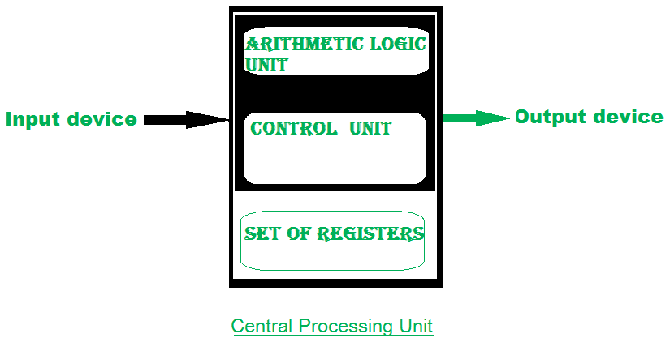
Arithmetic Logic Unit
The ALU is a digital circuit that provides arithmetic and logic operations. It is the fundamental building block of the central processing unit of a computer.
A modern CPU has a very powerful ALU and it is complex in design.

Slide 59
In addition to ALU modern CPU contains a control unit and a set of registers.
Most of the operations are performed by one or more ALU’s, which load data from the input register. Registers are a small amount of storage available to the CPU.
These registers can be accessed very fast. The control unit tells ALU what operation to perform on the available data.
After calculation/manipulation, the ALU stores the output in an output register.

Slide 60
Arithmetic for Computers
Operations on integers
Addition and subtraction
Multiplication and division
Dealing with overflow
Floating-point real numbers
Representation and operations

Slide 61
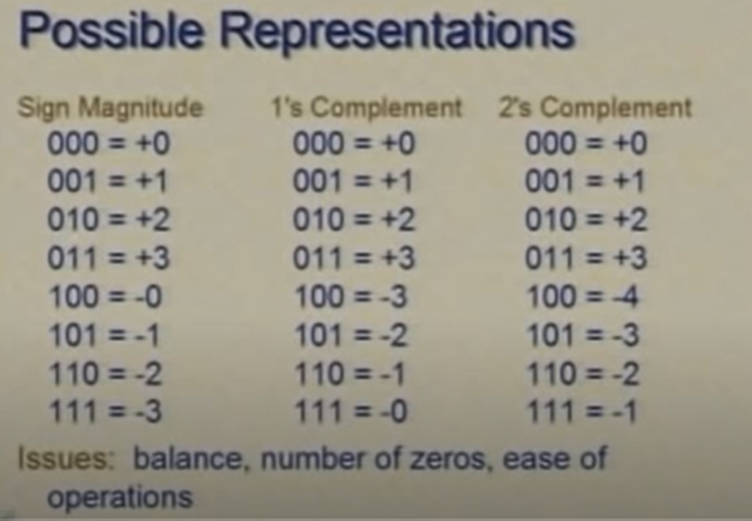
Possible Representations

Slide 62
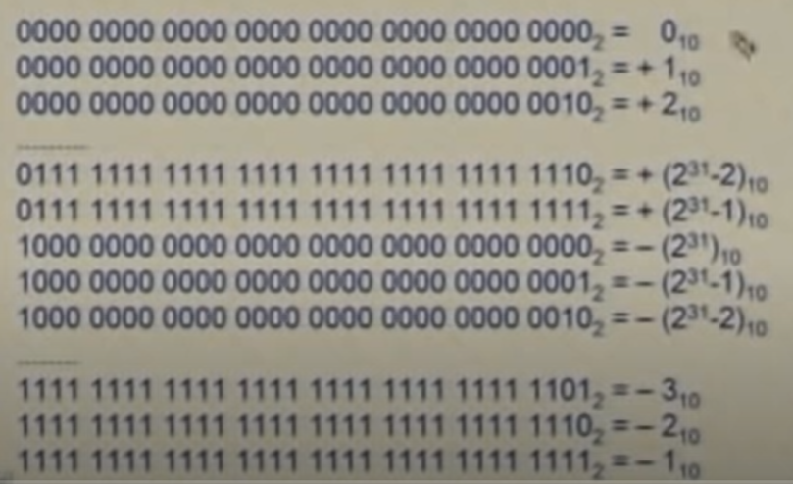
MIPS: 32-bit signed integers

Slide 63
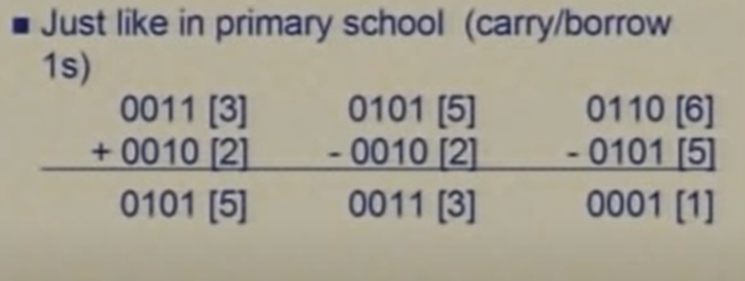
Addition and Subtraction

Slide 64
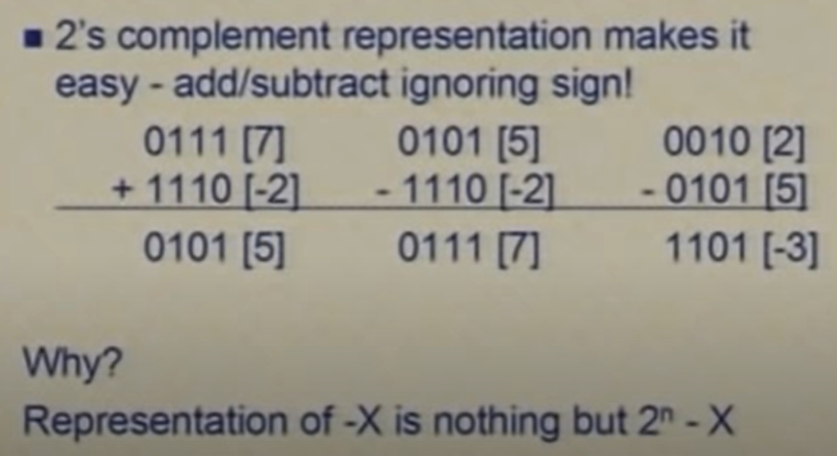
Add and Subtract

Slide 65
Overflow with Unsigned
Overflow with unsigned integers (commonly used for memory addresses) are ignored.
So, recognize overflow and raise exceptions in
add, addi, sub
Ignore overflow and do not raise exceptions in
addu, addiu, subu
addiu $s1, $s1, 35

Slide 66
Dealing with Overflow
Some languages (e.g., C) ignore overflow
Use MIPS addu, addui, subu instructions
Other languages (e.g., Ada, Fortran) require raising an exception
Use MIPS add, addi, sub instructions
On overflow, invoke exception handler
Save PC in exception program counter (EPC) register
Jump to predefined handler address
mfc0 (move from coprocessor 0) instruction can retrieve EPC value, to return after corrective action

Slide 67
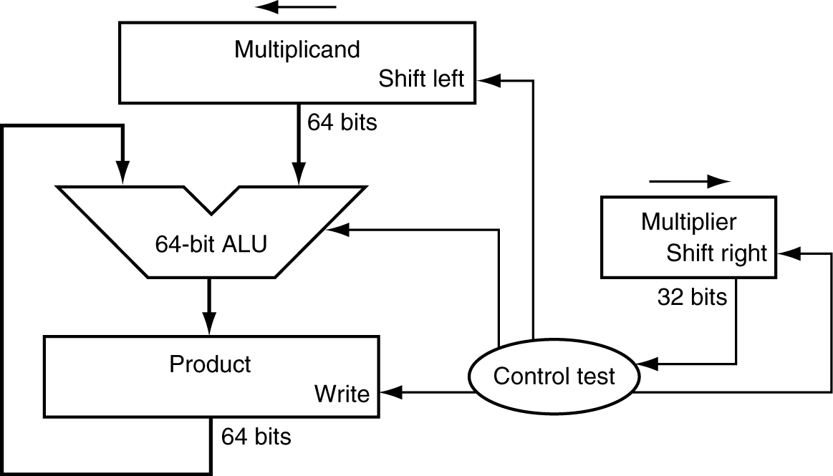
Multiplication
Start with long-multiplication approach
multiplicand
1000
× 1001
1000
0000
0000
1000
1001000
multiplier
product
Length of product is the sum of operand lengths

Slide 68
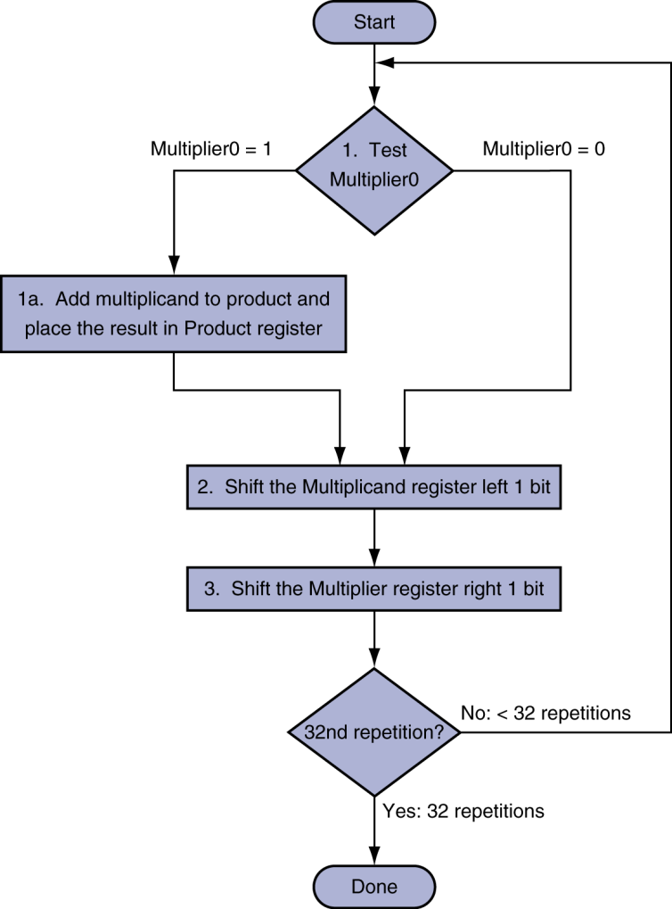

Multiplication Hardware
Initially 0

Slide 69
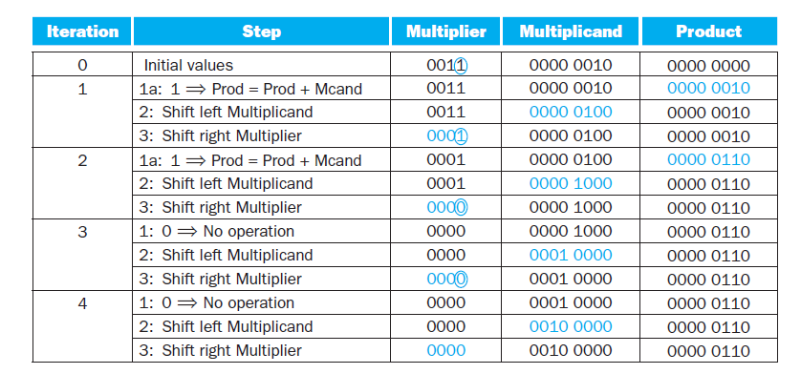
Example : 2 x 3

Slide 70
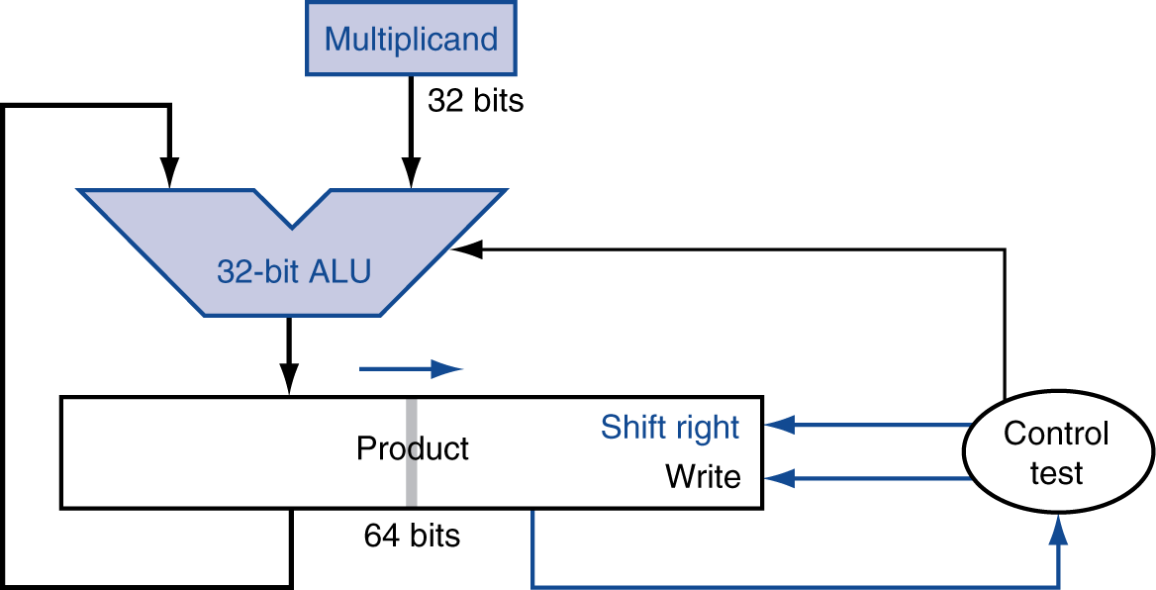
Optimized Multiplier
Perform steps in parallel: add/shift

Slide 71
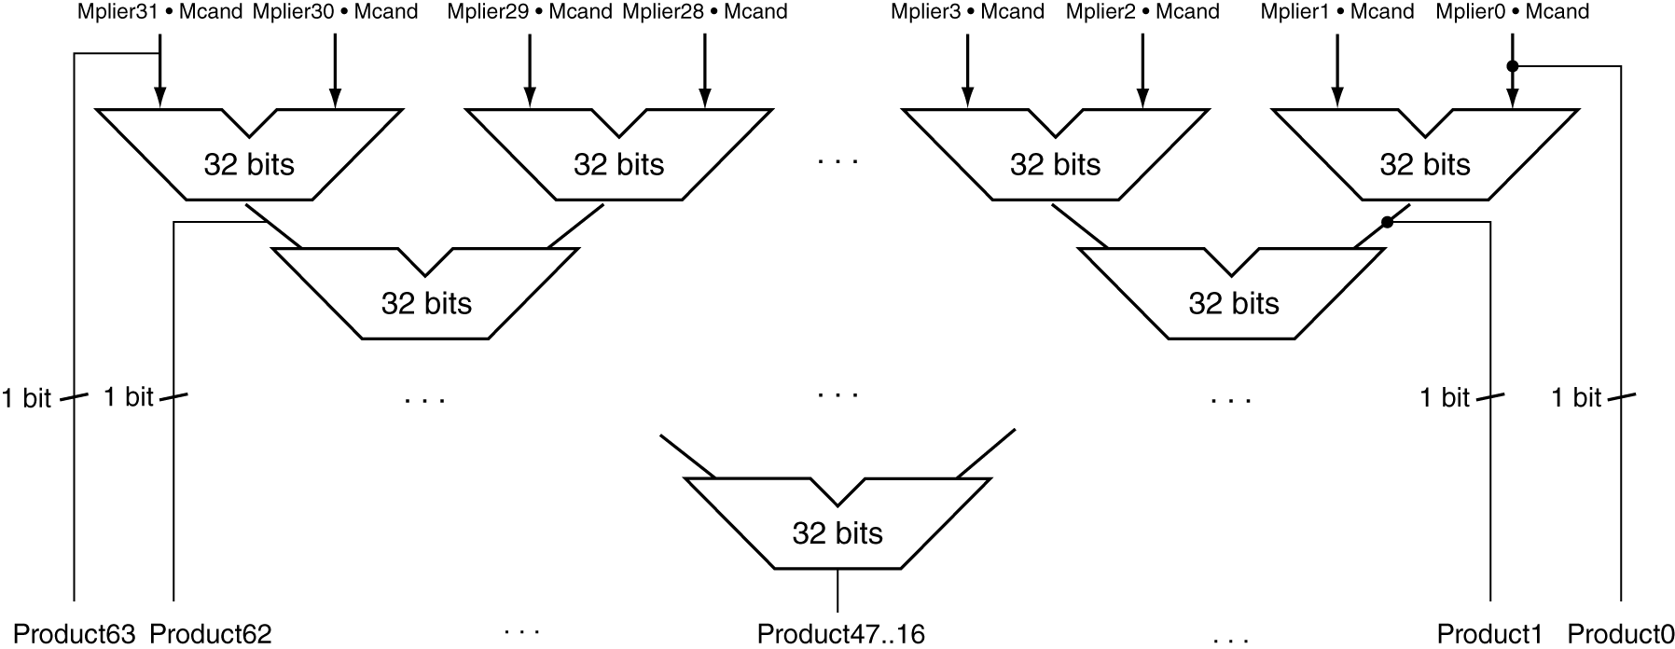
Faster Multiplier
Uses multiple adders
Cost/performance tradeoff
Can be pipelined
Several multiplication performed in parallel

Slide 72
MIPS Multiplication
Two 32-bit registers for product
HI: most-significant 32 bits
LO: least-significant 32-bits
Instructions
mult rs, rt / multu rs, rt
64-bit product in HI/LO
mfhi rd / mflo rd
Move from HI/LO to rd
Can test HI value to see if product overflows 32 bits
mul rd, rs, rt
Least-significant 32 bits of product –> rd

Slide 73
Division
Check for 0 divisor
Long division approach
If divisor ≤ dividend bits
1 bit in quotient, subtract
Otherwise
0 bit in quotient, bring down next dividend bit
Restoring division
Do the subtract, and if remainder goes < 0, add divisor back
Signed division
Divide using absolute values
Adjust sign of quotient and remainder as required
quotient
dividend
1001
1000 1001010
-1000
10
101
1010
-1000
10
divisor
remainder
n-bit operands yield n-bit quotient and remainder

Slide 74
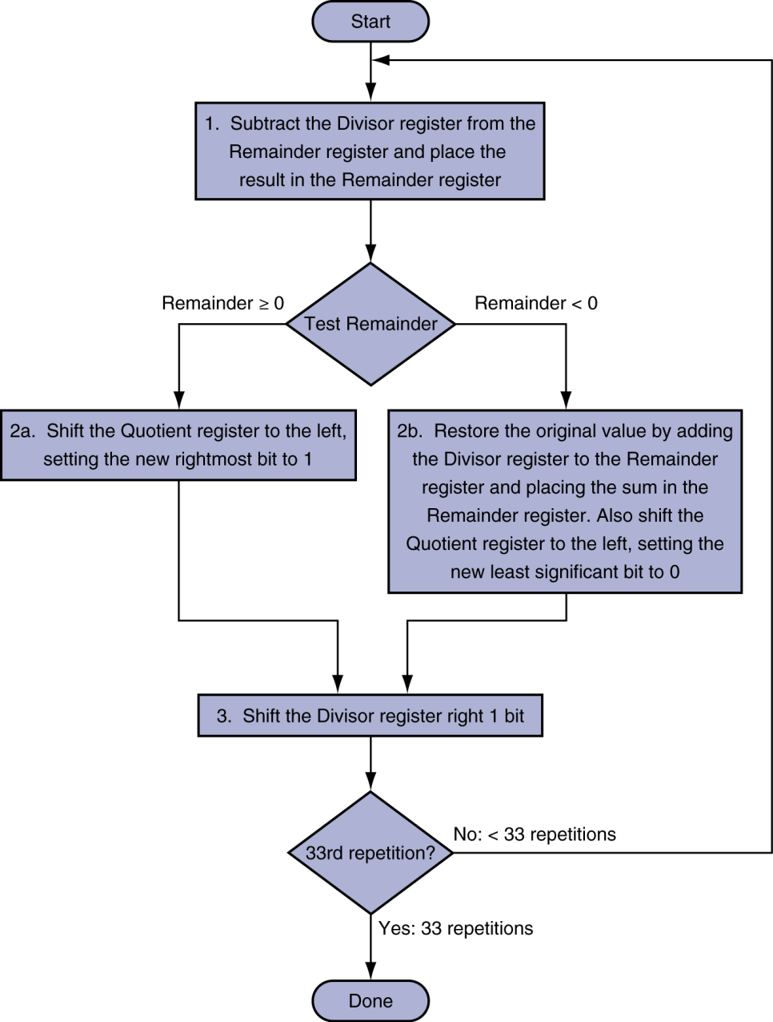
Division

Slide 75
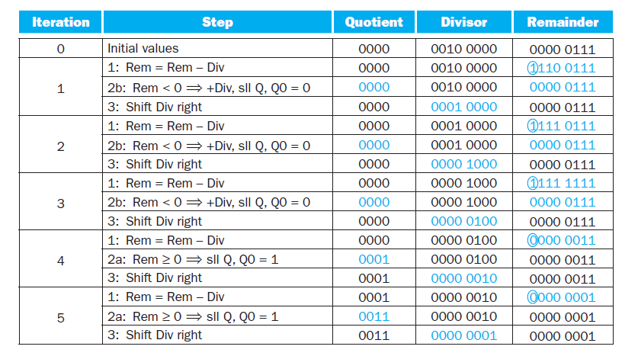
Division: 7 by 2

Slide 76
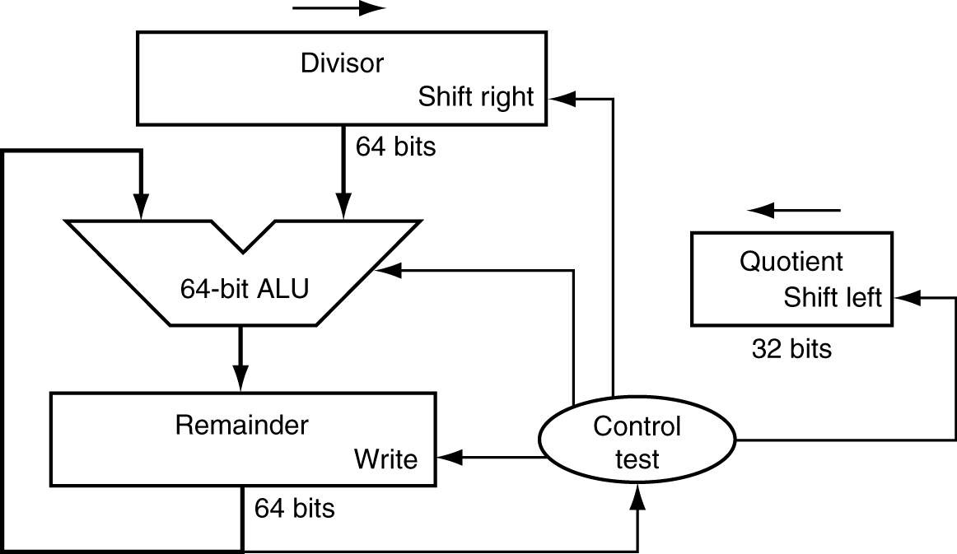
Division Hardware
Initially divisor in left half
Initially dividend

Slide 77
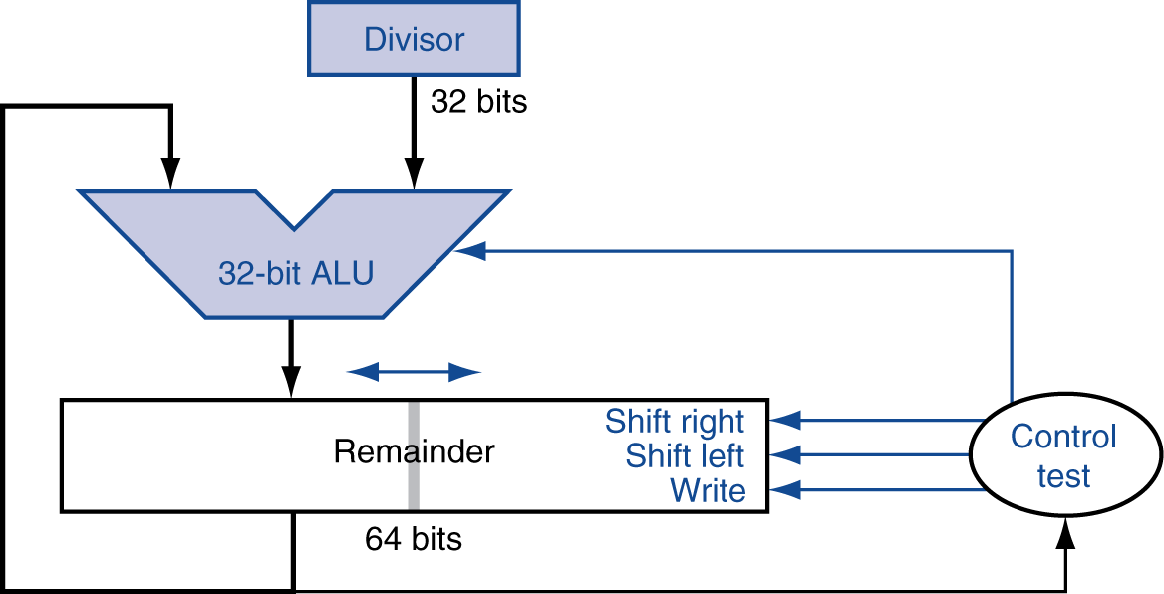
Optimized Divider
One cycle per partial-remainder subtraction
Looks a lot like a multiplier!
Same hardware can be used for both

Slide 78
MIPS Division
Use HI/LO registers for result
HI: 32-bit remainder
LO: 32-bit quotient
Instructions
div rs, rt / divu rs, rt
No overflow or divide-by-0 checking
Software must perform checks if required
Use mfhi, mflo to access result

Slide 79
Floating Point
Representation for non-integral numbers
Including very small and very large numbers
Like scientific notation
–2.34 × 10⁵⁶
+0.002 × 10^{–4}
+987.02 × 10⁹
In binary
±1.xxxxxxx₂ × 2^{yyyy}
Types float and double in C
normalized
not normalized

Slide 80
Floating Point Standard
Defined by IEEE Std 754-1985
Developed in response to divergence of representations
Portability issues for scientific code
Now almost universally adopted
Two representations
Single precision (32-bit)
Double precision (64-bit)

Slide 81

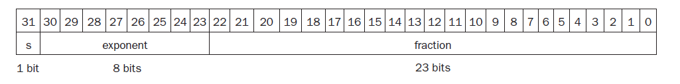
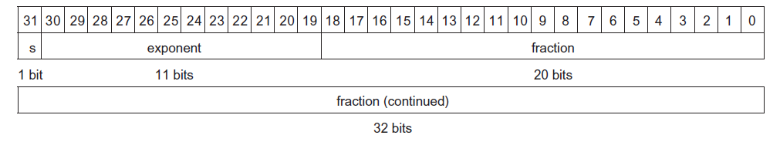
Floating Point
In general, the floating point numbers are of the form,
Single Precision
Double Precision

Slide 82
IEEE Floating-Point Format
single: 8 bits double: 11 bits
single: 23 bits double: 52 bits
S
Exponent
Fraction
S: sign bit (0 ⇒ non-negative, 1 ⇒ negative)
Normalize significand: 1.0 ≤ |significand| < 2.0
Always has a leading pre-binary-point 1 bit, so no need to represent it explicitly (hidden bit)
Significand is Fraction with the “1.” restored
Exponent: excess representation: actual exponent + Bias
Ensures exponent is unsigned
Single: Bias = 127; Double: Bias = 1023

Slide 83
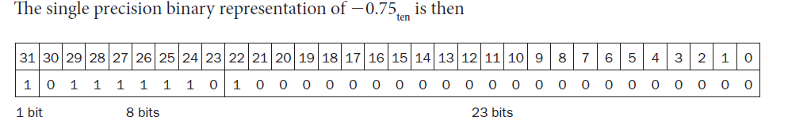
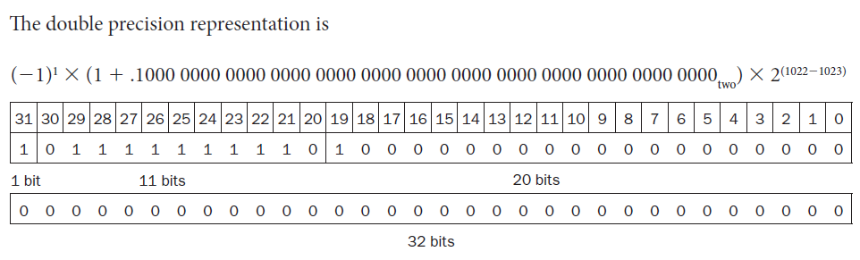
IEEE 754 format
Floating point numbers needs to be compared easily – for sorting
Placing the exponent before significand
Negative exponents pose a challenge to simplified sorting
Biased Notation – bias being subtracted from the normal, unsigned representation
So, the exponent in IEEE 754 format is

Slide 84
Single-Precision Range
Exponents 00000000 and 11111111 reserved
Smallest value
Exponent: 00000001 ⇒ actual exponent = 1 – 127 = –126
Fraction: 000…00 ⇒ significand = 1.0
±1.0 × 2^{–126} ≈ ±1.2 × 10^{–38}
Largest value
exponent: 11111110 ⇒ actual exponent = 254 – 127 = +127
Fraction: 111…11 ⇒ significand ≈ 2.0
±2.0 × 2⁺¹²⁷ ≈ ±3.4 × 10⁺³⁸

Slide 85
Double-Precision Range
Exponents 0000…00 and 1111…11 reserved
Smallest value
Exponent: 00000000001 ⇒ actual exponent = 1 – 1023 = –1022
Fraction: 000…00 ⇒ significand = 1.0
±1.0 × 2^{–1022} ≈ ±2.2 × 10^{–308}
Largest value
Exponent: 11111111110 ⇒ actual exponent = 2046 – 1023 = +1023
Fraction: 111…11 ⇒ significand ≈ 2.0
±2.0 × 2⁺¹⁰²³ ≈ ±1.8 × 10⁺³⁰⁸

Slide 86
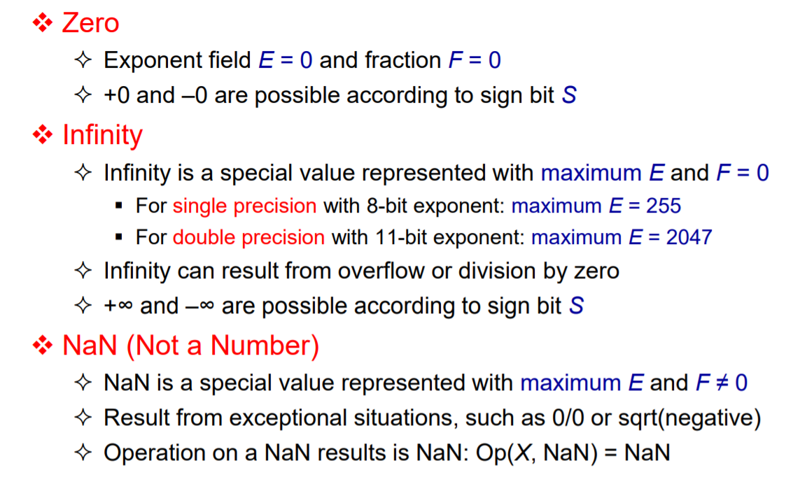
Zero, Infinity and NaN

Slide 87
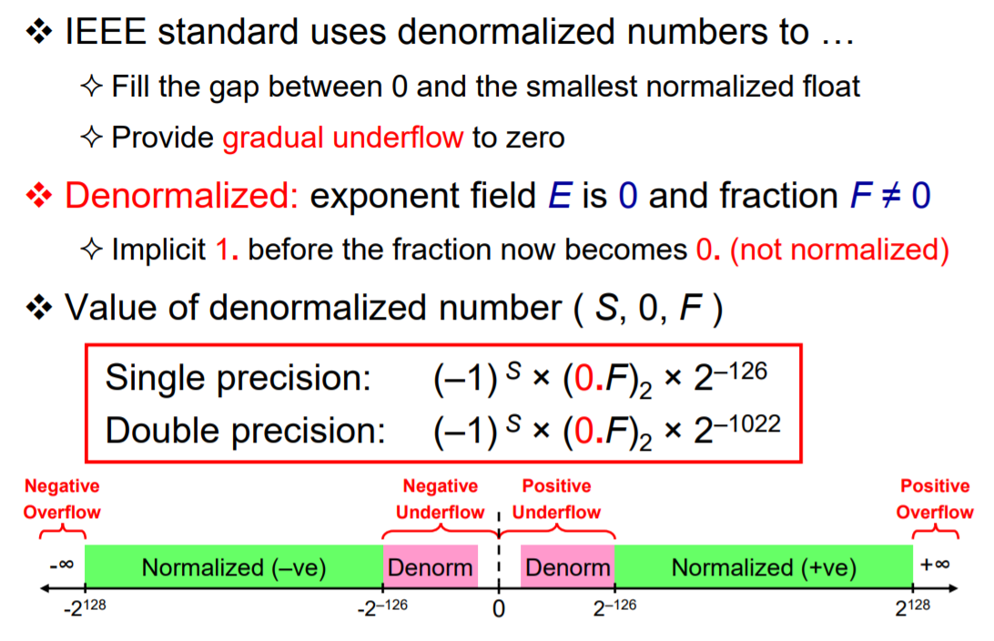
Denormalized Numbers
Numbers represented in Unnormalized form

Slide 88
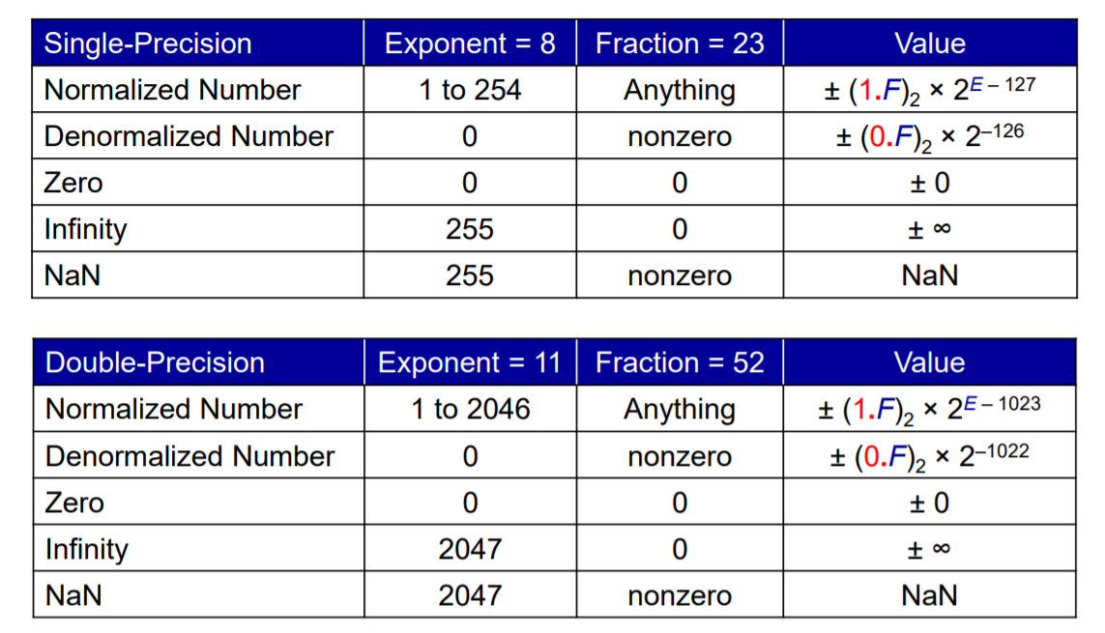
IEEE 754 Encoding Summary

Slide 89
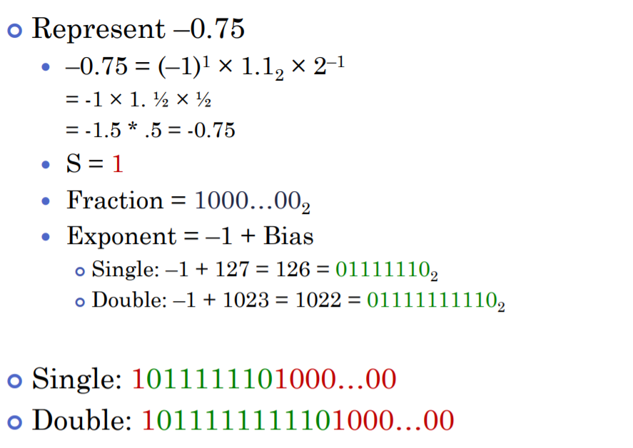
Floating Point Example

Slide 90
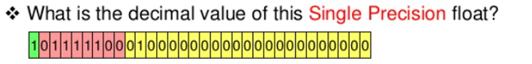
Example

Slide 91
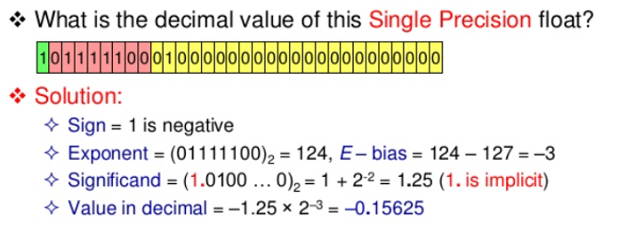
Example

Slide 92
FP Arithmetic Hardware
FP multiplier is of similar complexity to FP adder
But uses a multiplier for significands instead of an adder
FP arithmetic hardware usually does
Addition, subtraction, multiplication, division, reciprocal, square-root
FP ↔ integer conversion
Operations usually takes several cycles
Can be pipelined

Slide 93
FP Instructions in MIPS
FP hardware is coprocessor 1
Adjunct processor that extends the ISA
Separate FP registers
32 single-precision: $f0, $f1, … $f31
Paired for double-precision: $f0/$f1, $f2/$f3, …
FP instructions operate only on FP registers
FP load and store instructions
lwc1, ldc1, swc1, sdc1
e.g., ldc1 $f8, 32($sp)

Slide 94
FP Instructions in MIPS
Single-precision arithmetic
add.s, sub.s, mul.s, div.s
e.g., add.s $f0, $f1, $f6
Double-precision arithmetic
add.d, sub.d, mul.d, div.d
e.g., mul.d $f4, $f4, $f6
Single- and double-precision comparison
c.xx.s, c.xx.d (xx is eq, lt, le, …)
Sets or clears FP condition-code bit
e.g. c.lt.s $f3, $f4
Branch on FP condition code true or false
bc1t, bc1f
e.g., bc1t TargetLabel

Slide 95
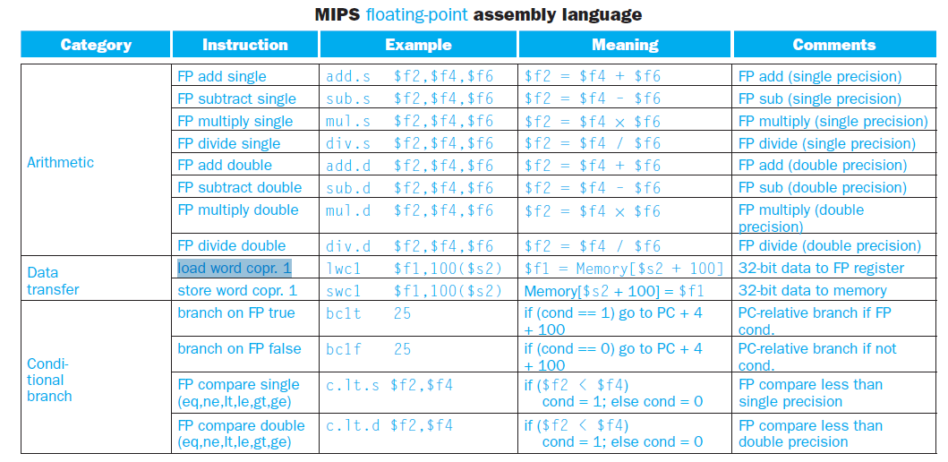
FP Instructions in MIPS

Slide 96
Who Cares About FP Accuracy?
Important for scientific code
But for everyday consumer use?
“My bank balance is out by 0.0002p!” ☹
The Intel Pentium FDIV bug
The market expects accuracy
Discovered by Prof. Thomas R. Nicely
Intel: “The common user would experience it once in 27 years”
IBM: “Bug occurs once in 24 days”
Intel apologized and made replacements on request

Slide 97
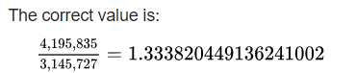
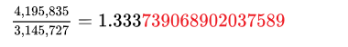
Intel Pentium FDIV Bug
Can be checked using Windows Calculator of MS Excel in Windows 95/98 in a computer with the Pentium line of processors

Slide 98
Accurate Arithmetic
IEEE Std 754 specifies additional rounding control
Extra bits of precision (guard, round, sticky)
Choice of rounding modes
Allows programmer to fine-tune numerical behavior of a computation
Not all FP units implement all options
Most programming languages and FP libraries just use defaults
Trade-off between hardware complexity, performance, and market requirements

Slide 99
Subword Parallellism
Graphics and audio applications can take advantage of performing simultaneous operations on short vectors
Example: 128-bit adder:
Sixteen 8-bit adds
Eight 16-bit adds
Four 32-bit adds
Also called data-level parallelism, vector parallelism, or Single Instruction, Multiple Data (SIMD)

Slide 100
x86 FP Architecture
Originally based on 8087 FP coprocessor
8 × 80-bit extended-precision registers
Used as a push-down stack
Registers indexed from TOS: ST(0), ST(1), …
FP values are 32-bit or 64 in memory
Converted on load/store of memory operand
Integer operands can also be converted on load/store
Very difficult to generate and optimize code
Result: poor FP performance

Slide 101
Streaming SIMD Extension 2 (SSE2)
Adds 4 × 128-bit registers
Extended to 8 registers in AMD64/EM64T
Can be used for multiple FP operands
2 × 64-bit double precision
4 × 32-bit double precision
Instructions operate on them simultaneously
Single-Instruction Multiple-Data

Slide 102
Concluding Remarks
Bits have no inherent meaning
Interpretation depends on the instructions applied
Computer representations of numbers
Finite range and precision
Need to account for this in programs
ISAs support arithmetic
Signed and unsigned integers
Floating-point approximation to reals
Bounded range and precision
Operations can overflow and underflow

Slide 103
Building a Datapath
Datapath
Elements that process data and addresses in the CPU
Registers, ALUs, mux’s, memories, …
We will build a MIPS datapath incrementally
Refining the overview design
§4.3 Building a Datapath

Slide 104
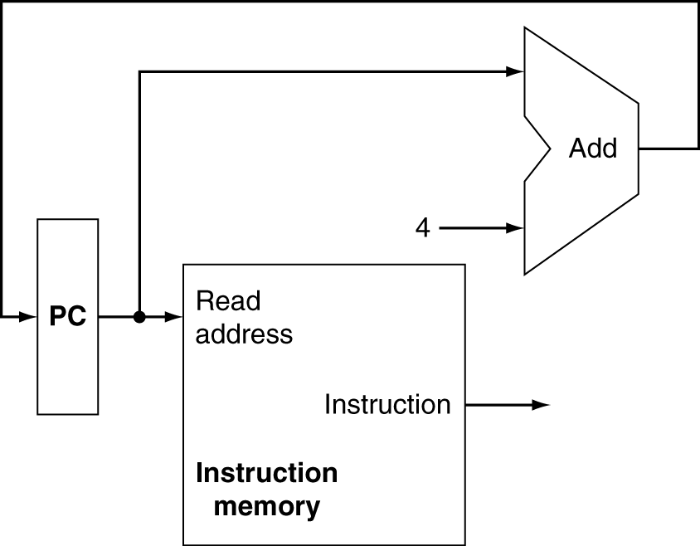
Instruction Fetch
Increment by 4 for next instruction
32-bit register

Slide 105
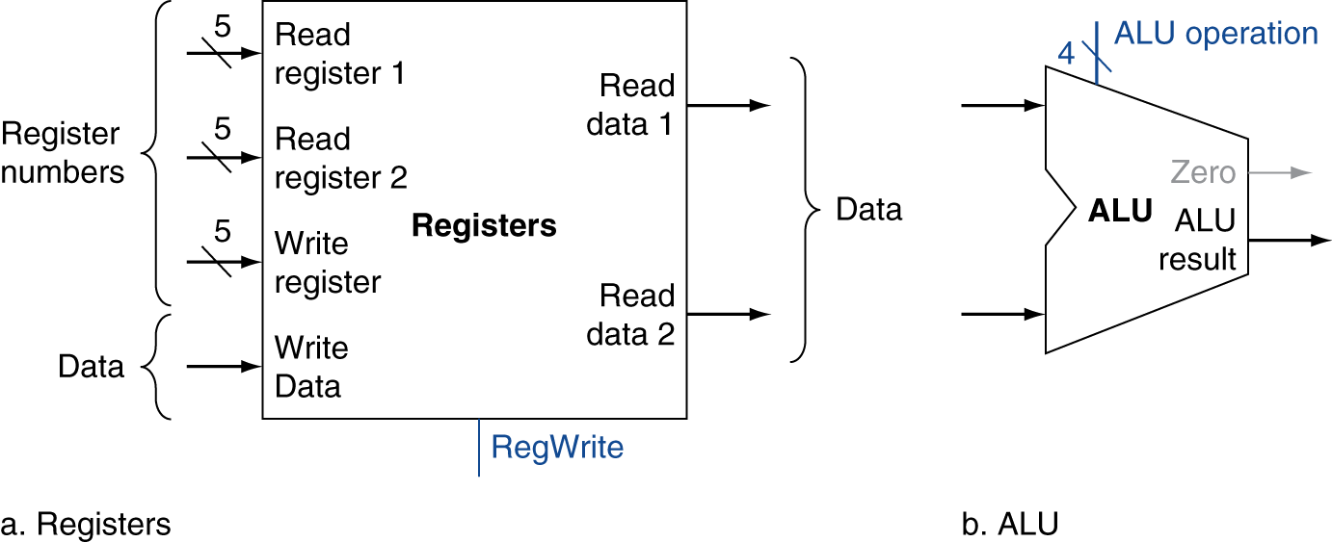
R-Format Instructions
Read two register operands
Perform arithmetic/logical operation
Write register result

Slide 106
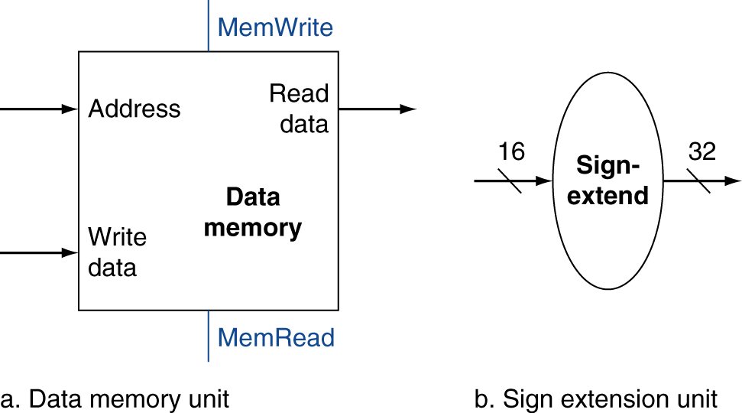
Load/Store Instructions
Read register operands
Calculate address using 16-bit offset
Use ALU, but sign-extend offset
Load: Read memory and update register
Store: Write register value to memory

Slide 107
Branch Instructions
Read register operands
Compare operands
Use ALU, subtract and check Zero output
Calculate target address
Sign-extend displacement
Shift left 2 places (word displacement)
Add to PC + 4
Already calculated by instruction fetch

Slide 108
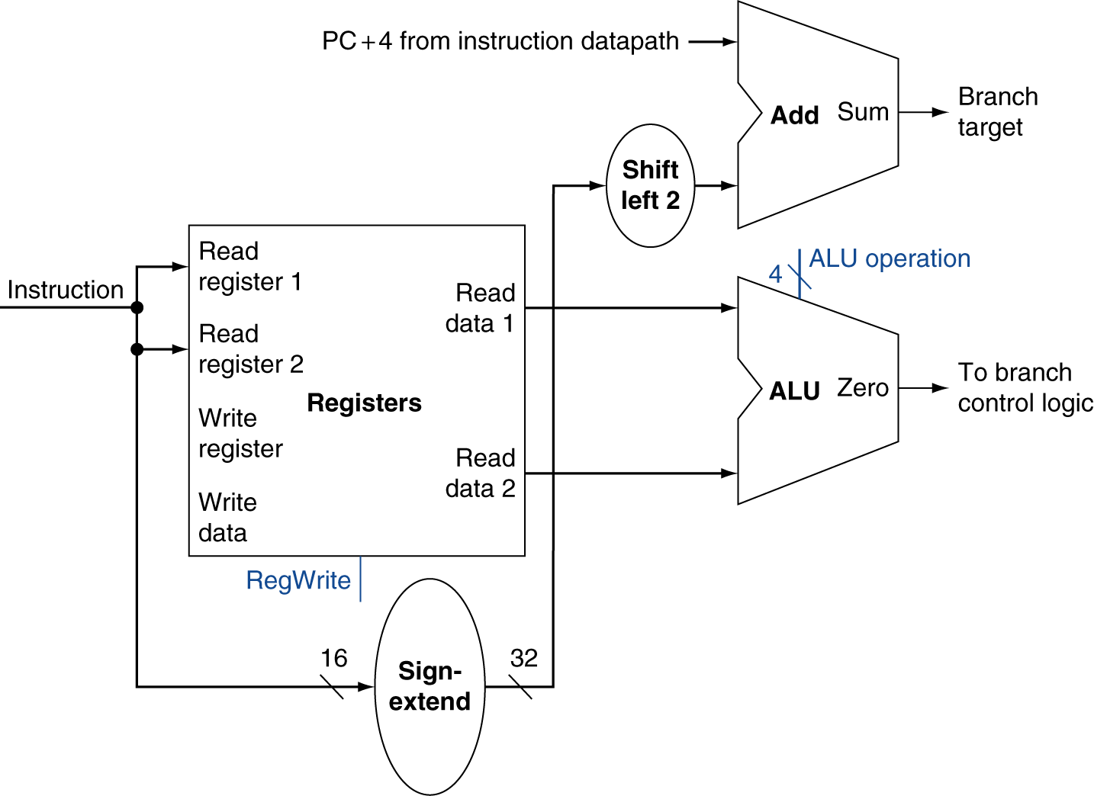
Branch Instructions
Just re-routes wires
Sign-bit wire replicated

Slide 109
Composing the Elements
First-cut data path does an instruction in one clock cycle
Each datapath element can only do one function at a time
Hence, we need separate instruction and data memories
Use multiplexers where alternate data sources are used for different instructions

Slide 110
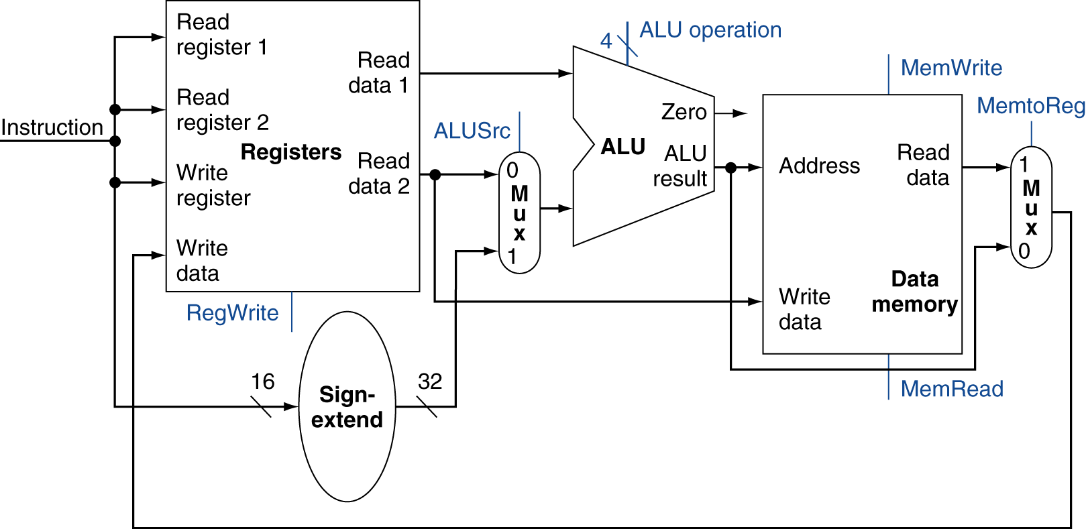
R-Type/Load/Store Datapath

Slide 111
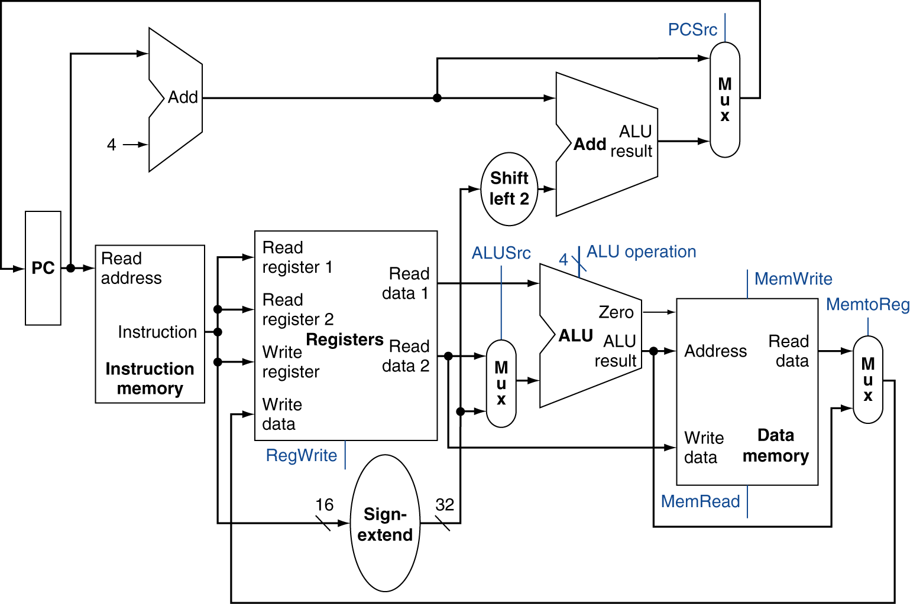
Full Datapath

Slide 112
ALU Control
ALU used for
Load/Store: F = add
Branch: F = subtract
R-type: F depends on funct field
§4.4 A Simple Implementation Scheme
ALU control | Function
0000 | AND
0001 | OR
0010 | add
0110 | subtract
0111 | set-on-less-than
1100 | NOR

Slide 113
ALU Control
Assume 2-bit ALUOp derived from opcode
Combinational logic derives ALU control
opcode | ALUOp | Operation | funct | ALU function | ALU control
lw | 00 | load word | XXXXXX | add | 0010
sw | 00 | store word | XXXXXX | add | 0010
beq | 01 | branch equal | XXXXXX | subtract | 0110
R-type | 10 | add | 100000 | add | 0010
 |  | subtract | 100010 | subtract | 0110
 |  | AND | 100100 | AND | 0000
 |  | OR | 100101 | OR | 0001
 |  | set-on-less-than | 101010 | set-on-less-than | 0111

Slide 114
The Main Control Unit
Control signals derived from instruction
R-type
0
rs
rt
rd
shamt
funct
31:26
25:21
20:16
15:11
10:6
5:0
Load/ Store
35 or 43
rs
rt
address
31:26
25:21
20:16
15:0
Branch
4
rs
rt
address
31:26
25:21
20:16
15:0
opcode
always read
read, except for load
write for R-type and load
sign-extend and add

Slide 115
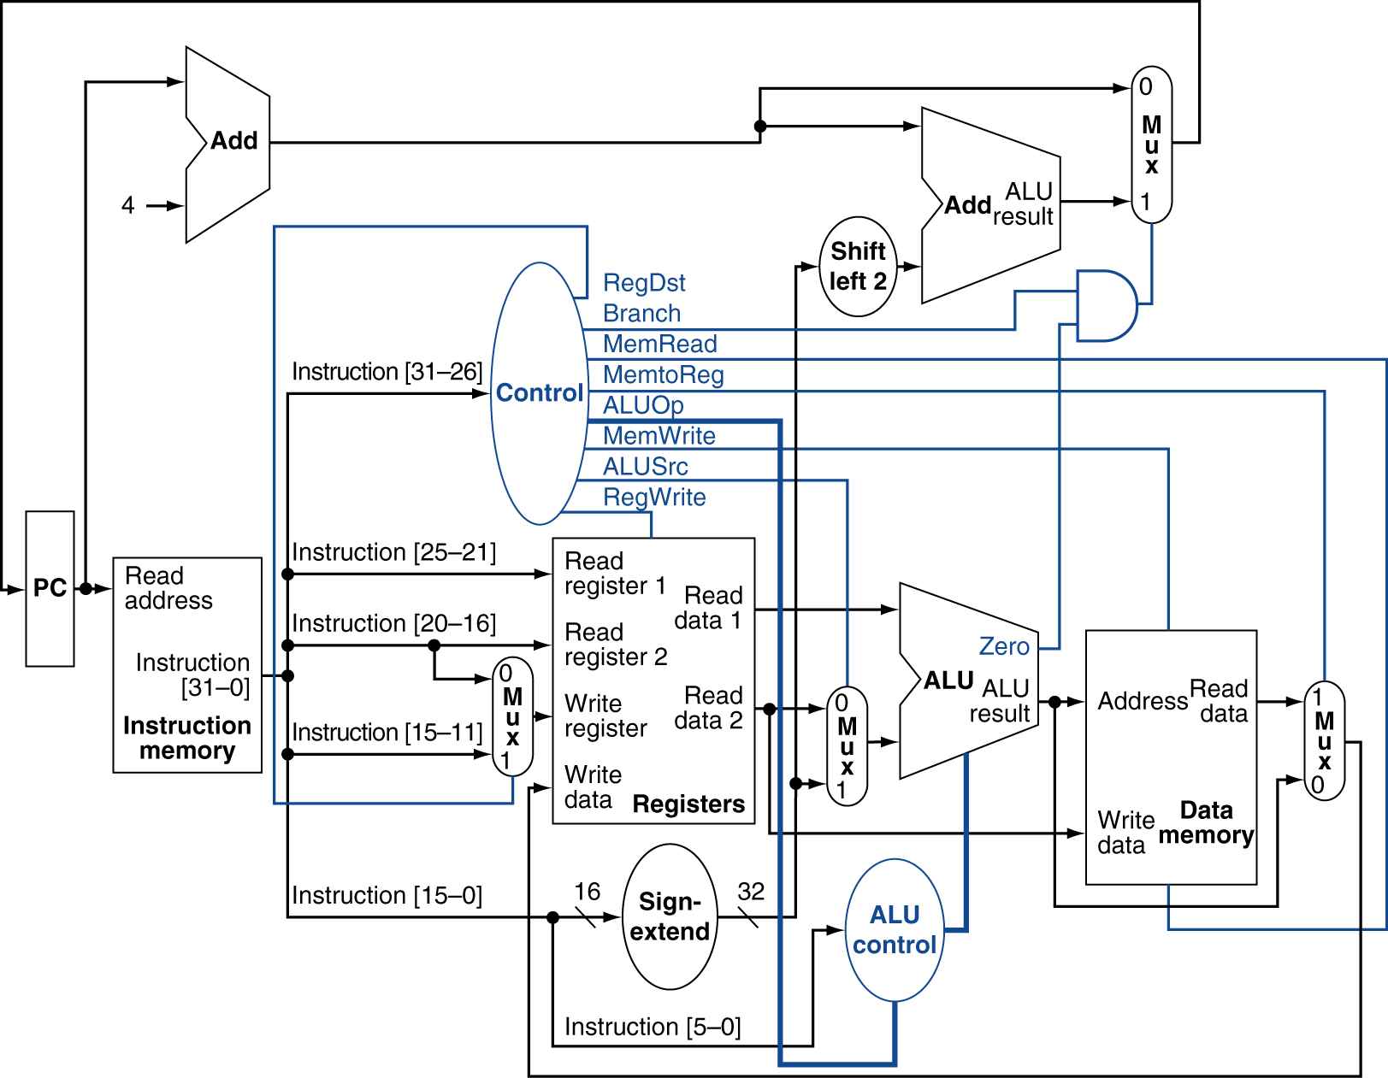
Datapath With Control

Slide 116
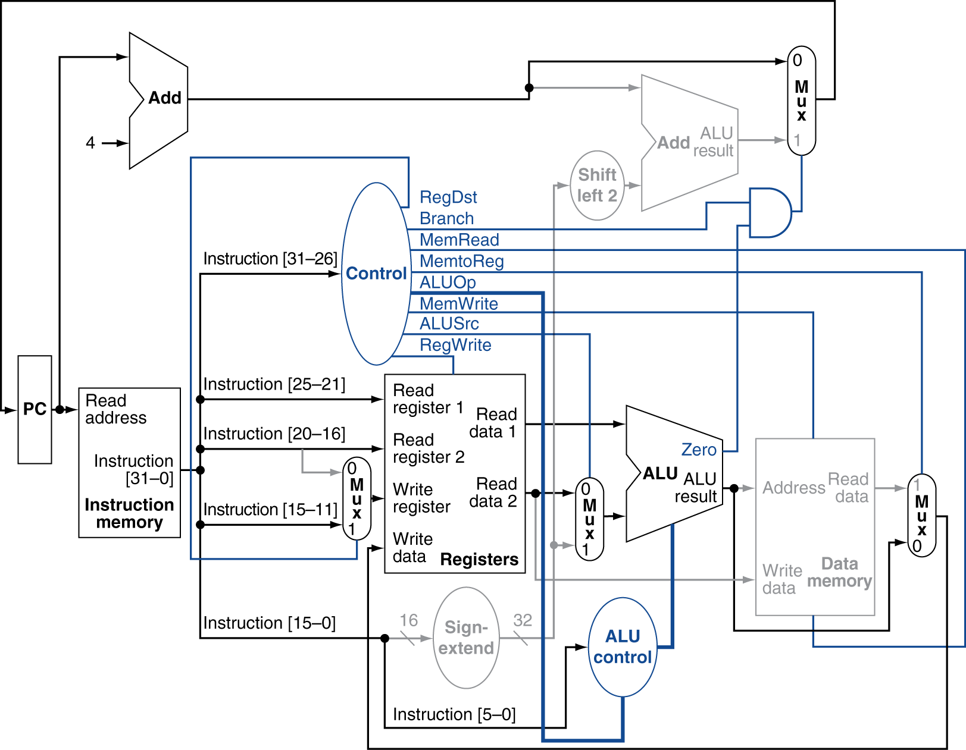
R-Type Instruction
0
rs
rt
rd
shamt
funct
31:26
25:21
20:16
15:11
10:6
5:0

Slide 117
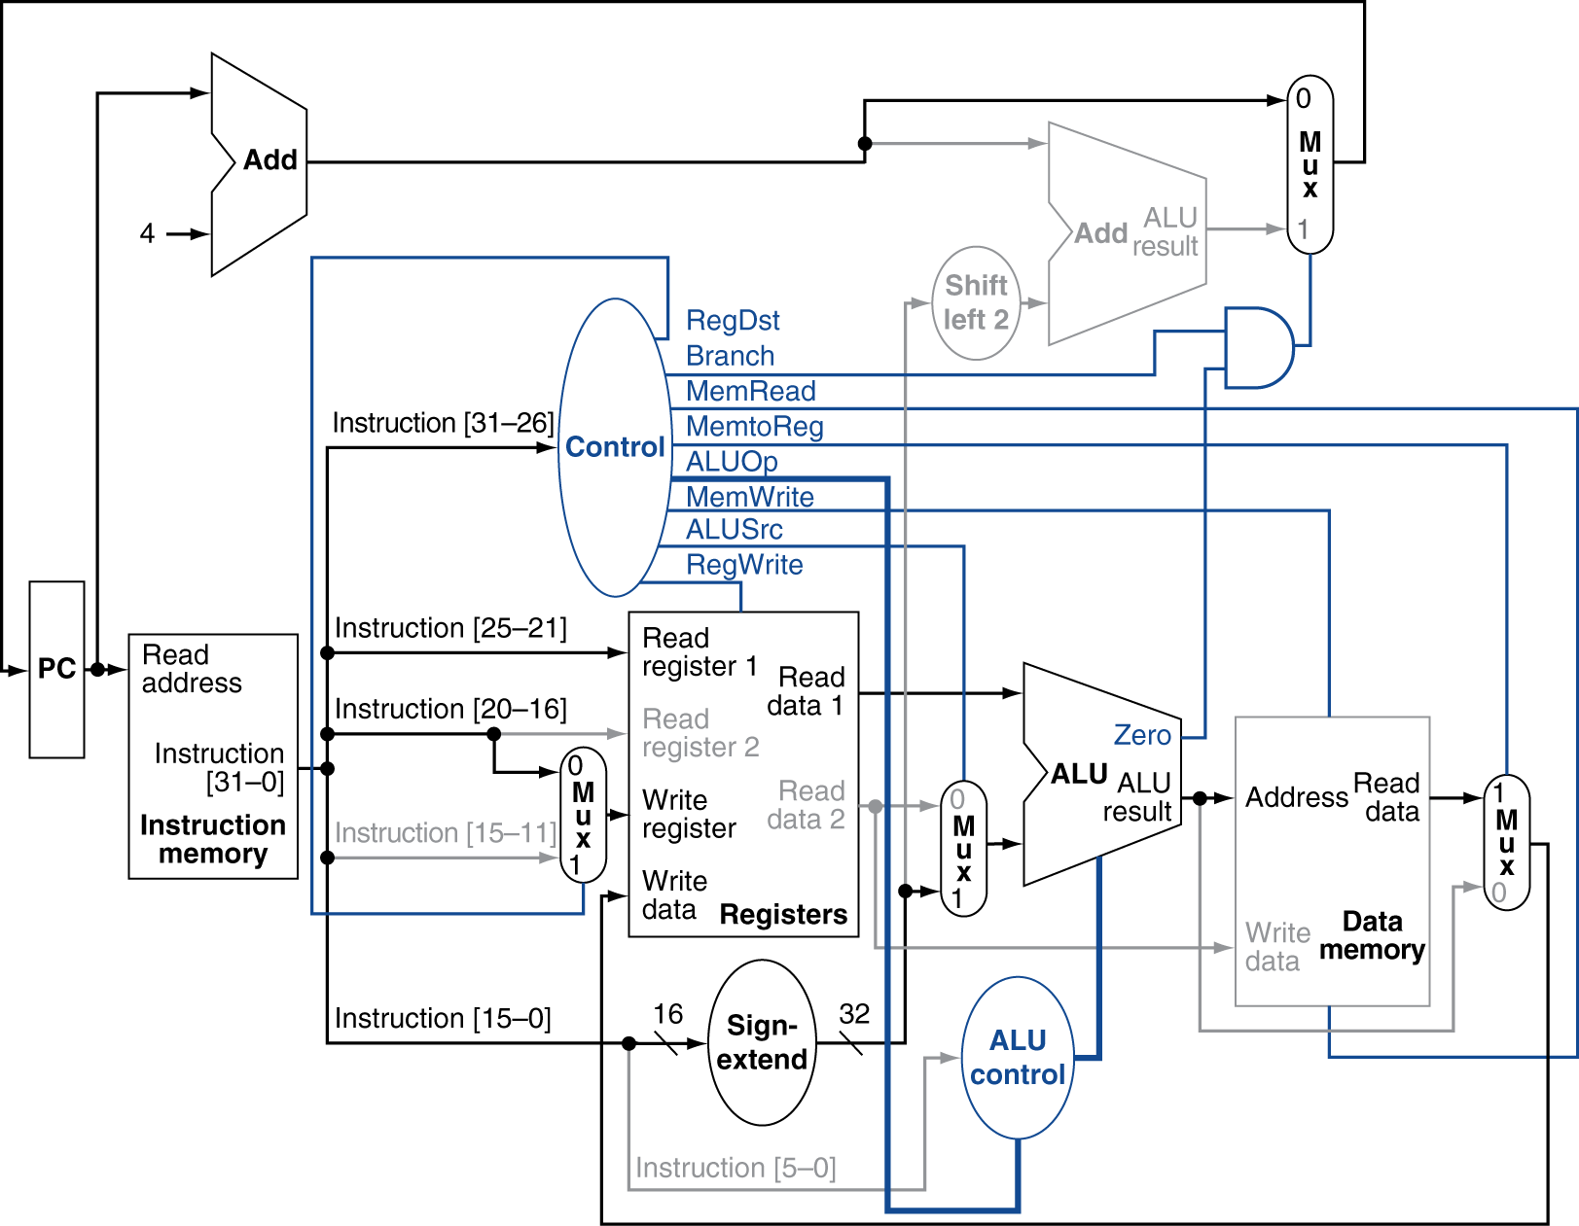
Load Instruction
35 or 43
rs
rt
address
31:26
25:21
20:16
15:0

Slide 118
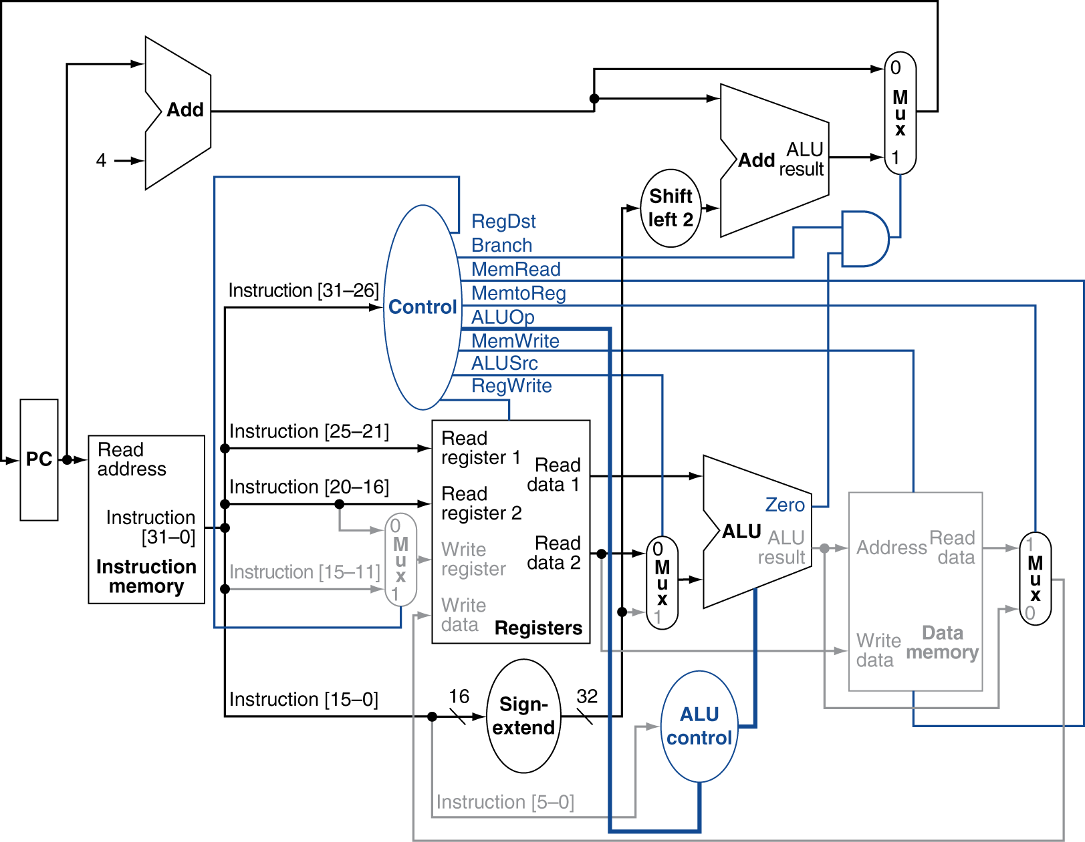
Branch-on-Equal Instruction
4
rs
rt
address
31:26
25:21
20:16
15:0

Slide 119
Implementing Jumps
Jump
2
address
31:26
25:0
Jump uses word address
Update PC with concatenation of
Top 4 bits of old PC
26-bit jump address
00
Need an extra control signal decoded from opcode

Slide 120
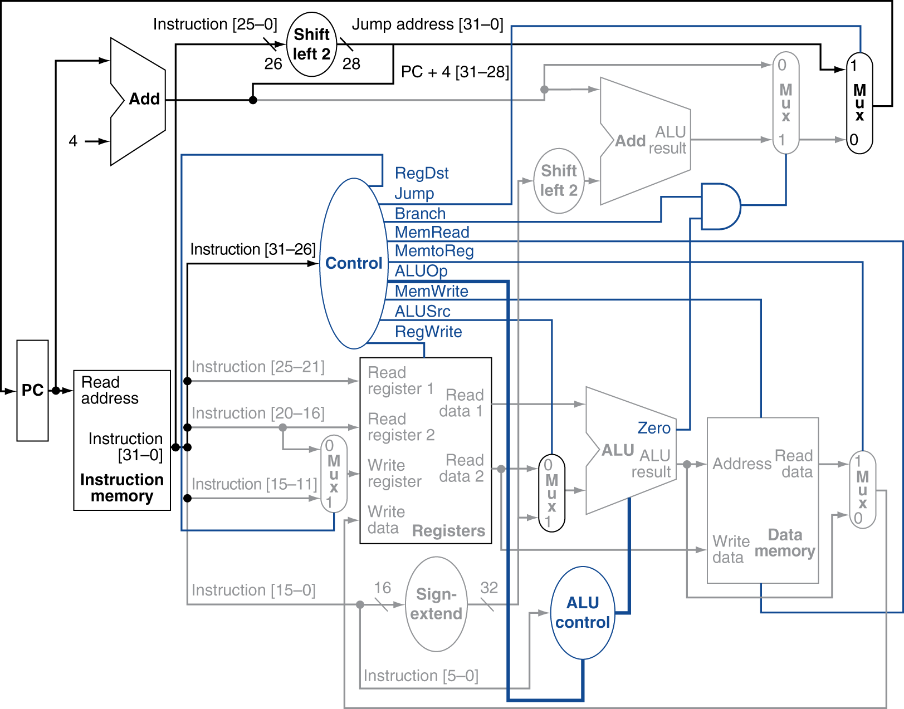

Datapath With Jumps Added
2
address
31:26
25:0

Slide 121
Performance Issues
Longest delay determines clock period
Critical path: load instruction
Instruction memory → register file → ALU → data memory → register file
Not feasible to vary period for different instructions
Violates design principle
Making the common case fast
We will improve performance by pipelining

Slide 122
Pipelining

Slide 123
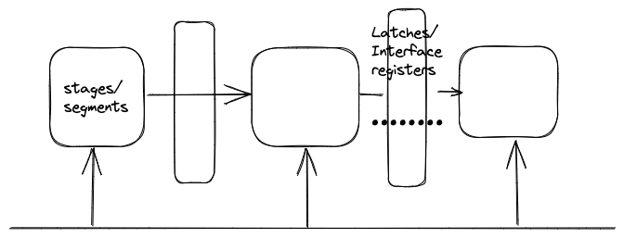
Pipelining
Process of arrangement of hardware elements of CPU in such way that its overall performance is increased.
Simultaneous execution of more than one process at a time.
Overlapping in execution

Slide 124
Pipelined vs Non-Pipelined
1 CC for Instruction
5 Stages (K)
8 Instructions (n)
[ K + (n – 1) ] CC
Speedup = NP/P
Efficiency/Utilisation = Blocks used/ Blocks there

Slide 125
Question – GATE CS 2004
A 4 - stage pipeline has the stage delays as 150, 120, 160 and 140 nanoseconds respectively. Registers that are used between the stages have a delay of 5 nanoseconds each. Assuming constant clocking rate, the total time taken to process 1000 data items on this pipeline will be
Answer: 165.5 ms

Slide 126

Question – GATE CS 2015
Consider a non-pipelined processor with a clock rate of 2.5 gigahertz and average cycles per instruction of four. The same processor is upgraded to a pipelined processor with five stages; but due to the internal pipeline delay, the clock speed is reduced to 2 gigahertz. Assume that there are no stalls in the pipeline. The speed up achieved in this pipelined processor is __________.
Answer: 3.2

Slide 127
Hazards in pipelining
Data Hazards
RAW To
WAW Output
WAR Anti
Structural Hazards
Control Hazards

Slide 128
Question – GATE CS 2018
The instruction pipeline of a RISC processor has the following stages: Instruction Fetch (IF), Instruction Decode (ID), Operand Fetch (OF), Perform Operation (PO) and Writeback (WB), The IF, ID, OF and WB stages take 1 clock cycle each for every instruction. Consider a sequence of 100 instructions. In the PO stage, 40 instructions take 3 clock cycles each, 35 instructions take 2 clock cycles each, and the remaining 25 instructions take 1 clock cycle each. Assume that there are no data hazards and no control hazards.
The number of clock cycles required for completion of execution of the sequence of instruction is ______ .
Answer: 219

Slide 129
Question – GATE CS 2022
A processor X1 operating at 2 GHz has a standard 5-stage RISC instruction pipeline having a base CPI (cycles per instruction) of one without any pipeline hazards. For a given program P that has 30% branch instructions, control hazards incur 2 cycles stall for every branch. A new version of the processor X2 operating at same clock frequency has an additional branch predictor unit (BPU) that completely eliminates stalls for correctly predicted branches. There is neither any savings nor any additional stalls for wrong predictions. There are no structural hazards and data hazards for X1 and X2. If the BPU has a prediction accuracy of 80%, the speed up (rounded off to two decimal places) obtained by X2 over X1 in executing P is ______.
Answer: 1.428

